Slide 1





Odoo Projects
Usman Ghias

Slide 2


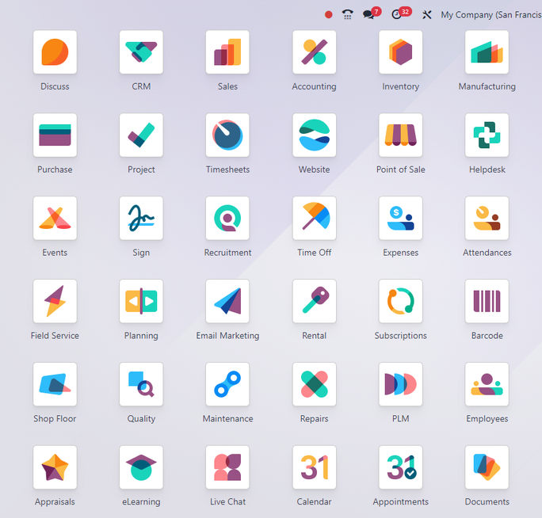


Introduction
With 86+ custom-built Odoo modules and 12+ complex integrations, our solutions are designed to transform business operations through tailored automation, efficiency, and scalability. As an Odoo specialist with 4+ years of development experience, I’ve engineered modules spanning HR, Sales, Inventory, Manufacturing, and Finance—each optimized for performance, compliance, and user experience.
2

Slide 3

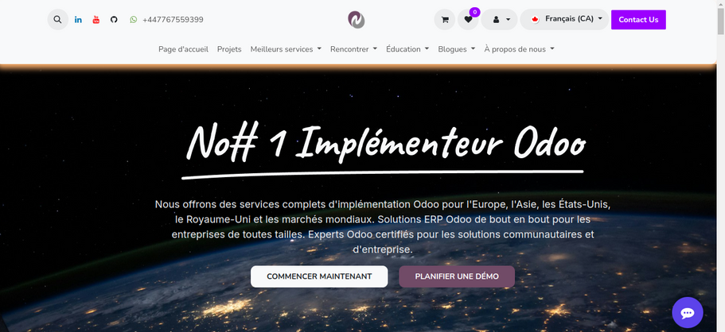

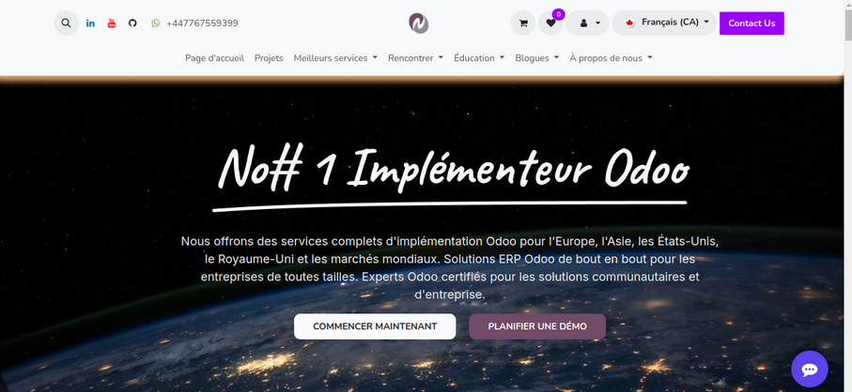



Our Projects
Sales & CRM (9 Modules)
Alternative Product Recommendations
Sales Sequence Generator
Order Automation Engine
Excel Order Line Importer
Client ID Number Management
Sales Template Management
Odoo 16 Sales Module
Price Locking System
Restricted Product Management
3

Slide 4
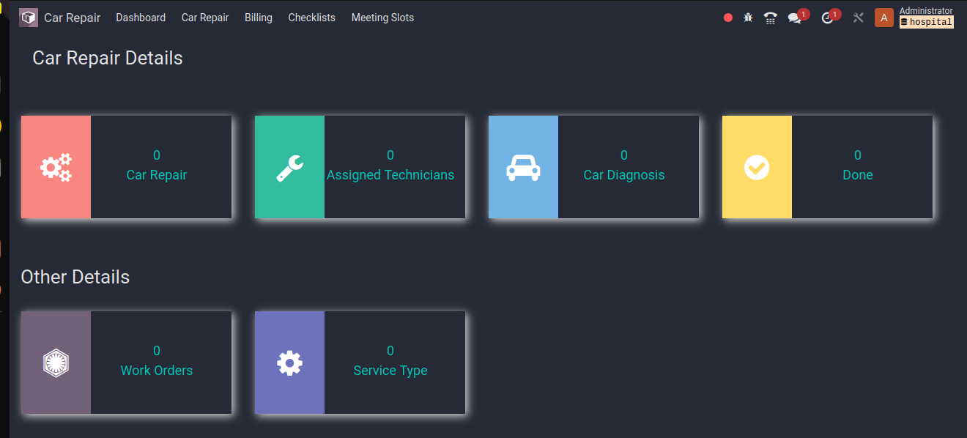
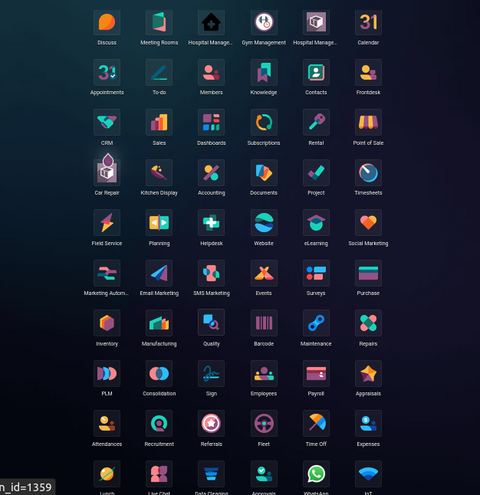
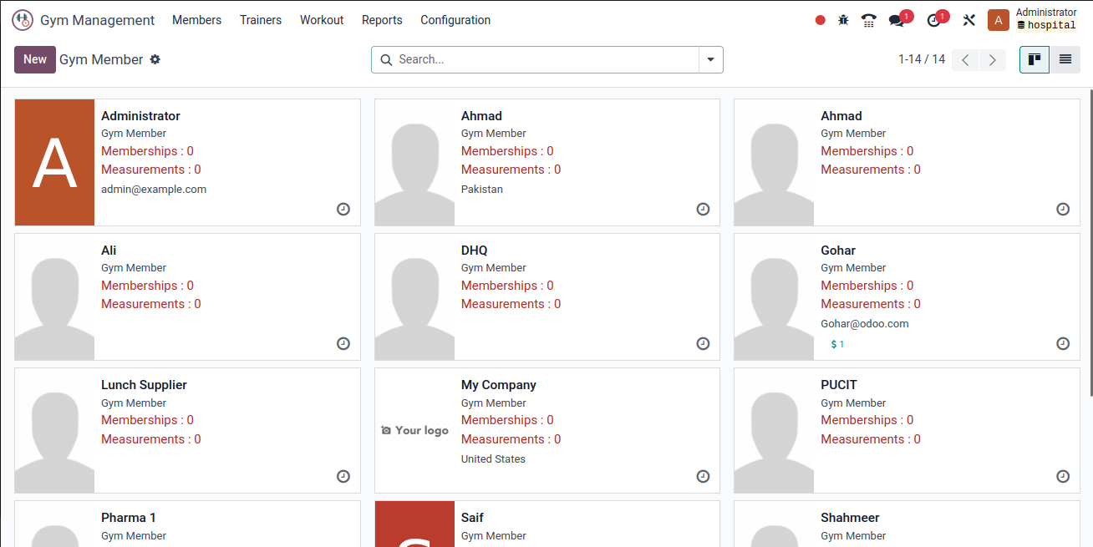
Dashboards

Slide 5





HR Management Suite (14 Modules)
1
2
3
Employee Document Expiry Tracking
Geo-Fenced Attendance System
KPI Management Framework
Annual Leave Allocation (v15)
Administrative Decision Workflows
Employee Training Management
Custom Contract Fields Extension
HR Policy Portal
Workforce Notification System
Payroll Identification System
Employee Profile Locking
HR Process Custom Fields
Administrative Change Management
Multi-Company HR Policies

Slide 6
Inventory Mastery (13 Modules)
1
2
3
Negative Stock Management
Multi-Warehouse Control
Stock Request System
Serial Number Tracking
Advanced Location Routing
Cycle Counting Module
Inventory Valuation Extensions
Stock Movement Analytics
Scrap Management System
Cross-Docking Features
Lot Expiration Alerts
Inventory Accuracy Reports
Mobile Scanning Integration

Slide 7
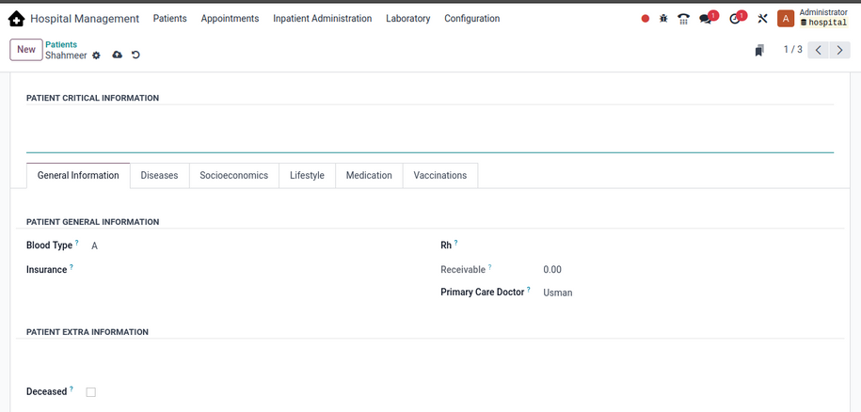
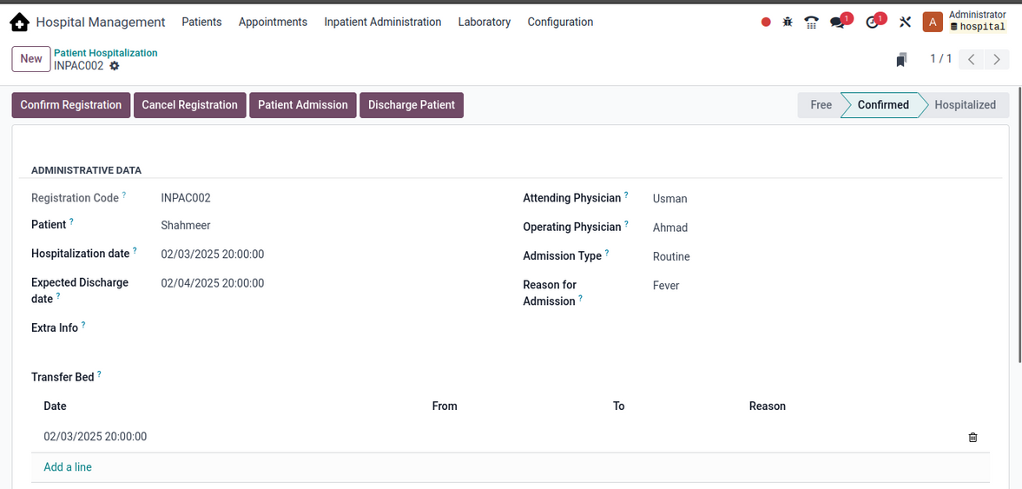
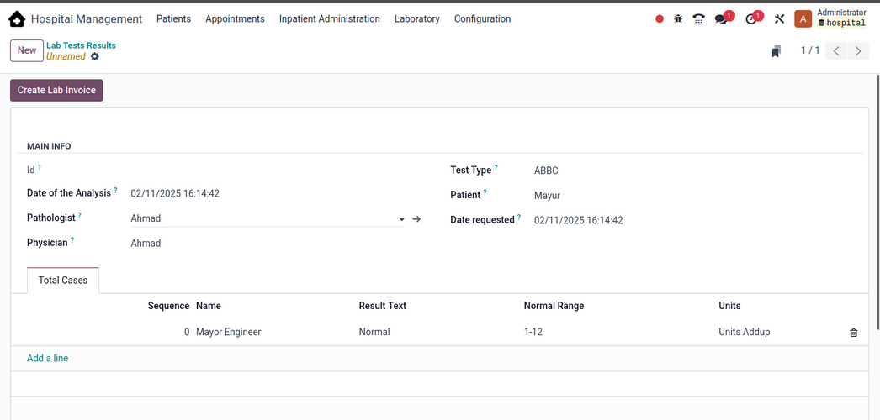
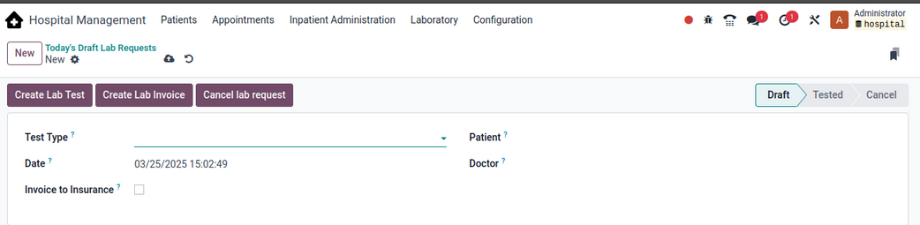
Odoo Projects

Slide 8


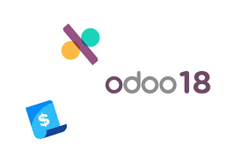



Financial Modules (12 Modules)
Arabic Invoice Formatting
Payment Preview System
Account Custody Management
Multi-Currency Enhancements
Extended Chart of Accounts
Check Printing System
Expense Allocation Engine
Tax Calculation Extensions
Payment Term Customizer
GL Account Locking
Budget vs Actual Analytics
Asset Depreciation Tools
8

Slide 9
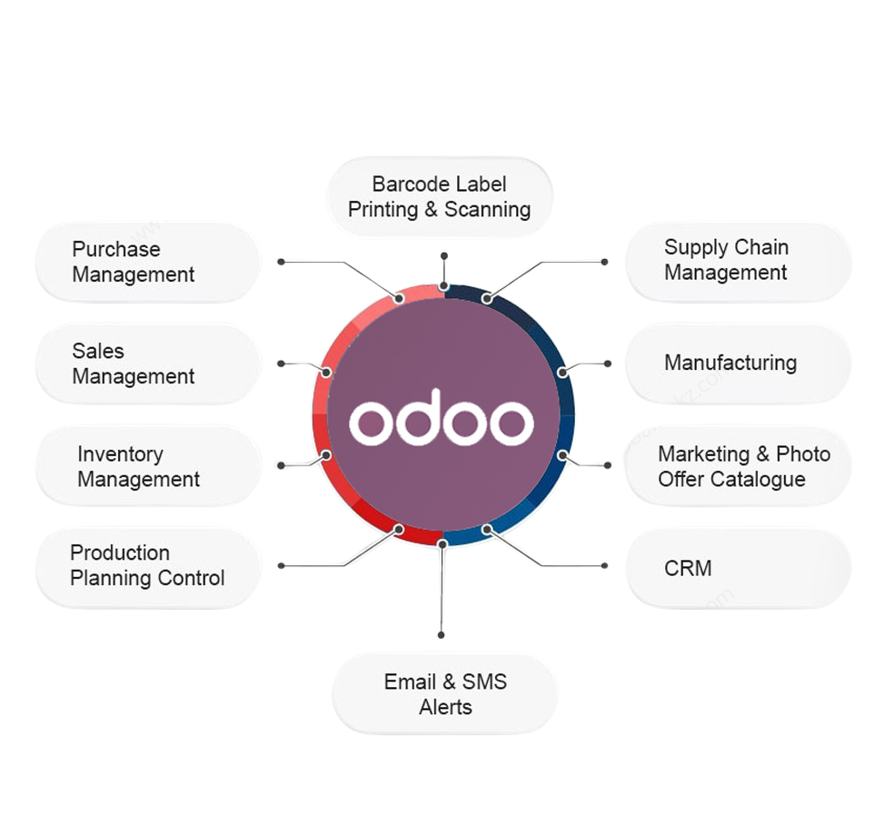
Manufacturing & Projects (7 Modules)
Job Costing Management
Workshop Repair System
BOM Version Control
Production Routing Analytics
Project Document Control
Quality Check Points
Maintenance Scheduling
9

Slide 10


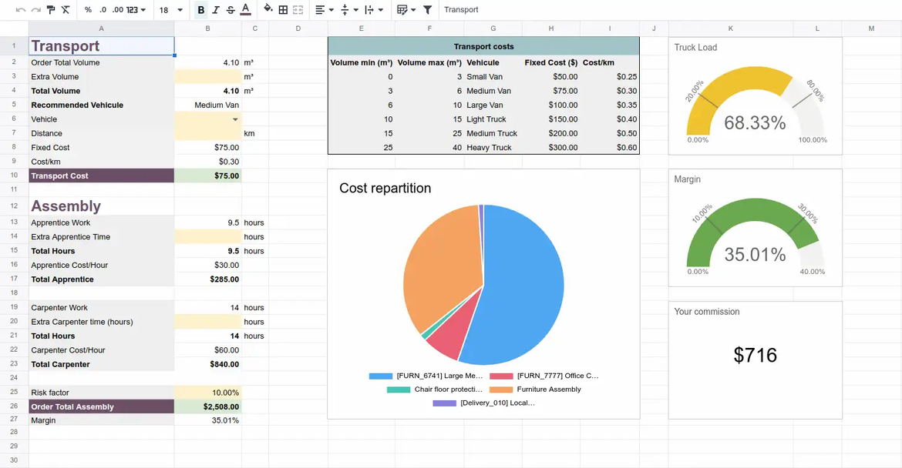




Document Management (8 Modules)
Expiry Alert System
Customer Portal Docs
Role-Based Security
Version Control System
OCR Integration (Urdu/English)
Document Workflow Engine
Approval Routing System
Audit Trail Module
10

Slide 11
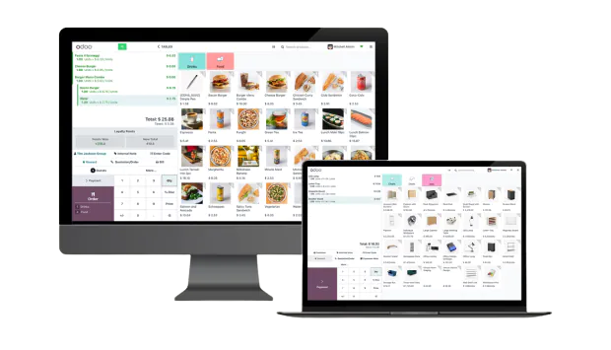
POS & Retail (6 Modules)
Custom Receipt Designer (v15)
Multi-Price List Support
Offline Sales Mode
Loyalty Program Integration
Inventory Sync Engine
Customer Display Module
11

Slide 12

Technical Framework (6 Modules)
Advanced Domain Widget
Multi-Company Base
REST API Extensions
Celery Integration
Real-Time Dashboards
Automated Testing Suite
12

Slide 13








Project Timeline
We strictly follow the project time line given by the client before approval.
Discovery Phase
Agile Strategy
Testing
Go-Live & Hypercare
Testing Requirements
Functional Flow, Tips and Tricks of Odoo
Process gap analysis
Customization scope finalization
Bi-weekly demo cycles
Priority-based module rollout
Phased deployment
30-day post-launch support
13

Slide 14
Thank You
Usman Ghias & Team

